Slide 1
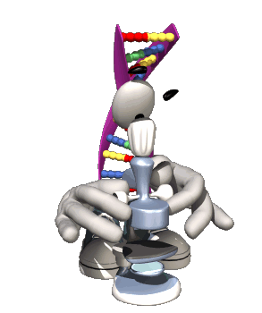
Genetics and Heredity
Notes:
1

Slide 2
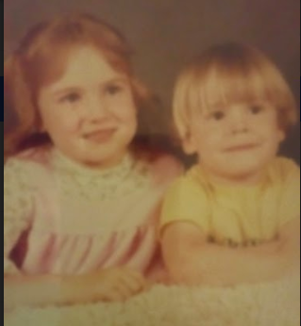
ENGAGE
How is it possible that the siblings in the picture have the exact same parents but do not really look alike?
How does a man with brown hair and a woman with blonde hair have a child with red hair?
WATCH THE ALLELES AND GENES EDPUZZLE TO FIND OUT.

Slide 3
EXPLORE
Is it possible to have the same traits as your classmates even though you aren’t related?
EXPLORE - HUMAN TRAITS LAB

Slide 4
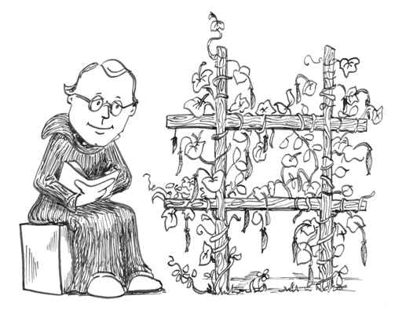
Gregor Johann Mendel (1822 – 1884)
Austrian monk
Developed the laws governing the inheritance of traits by cultivating and testing over 28,000 pea plants.
He discovered that the plants' offspring retained traits of the parents.
Father of Genetics
4

Slide 5
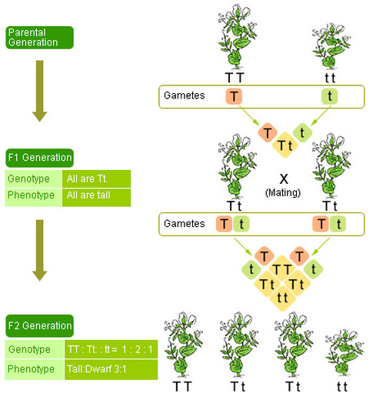
Mendel’s Peas

Slide 6
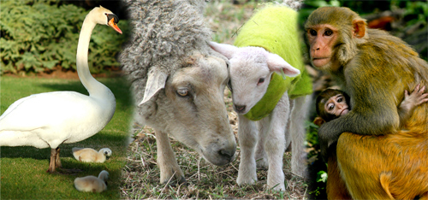
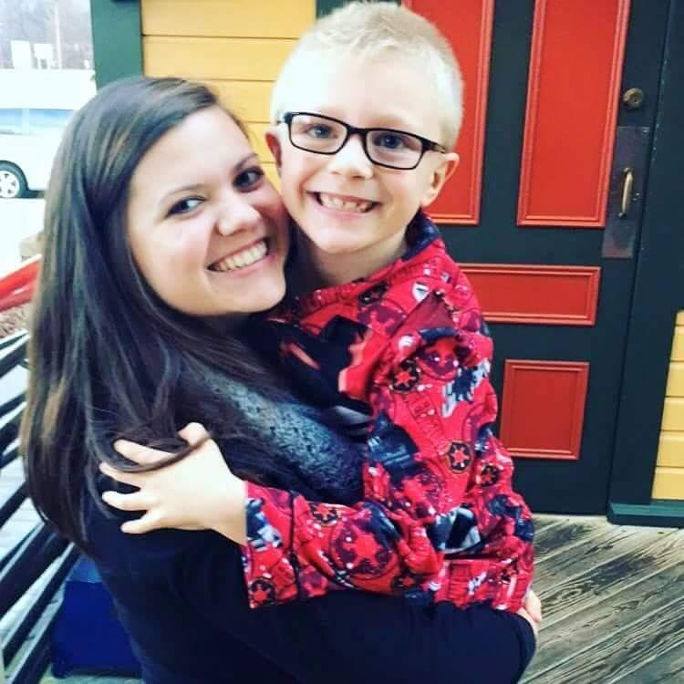
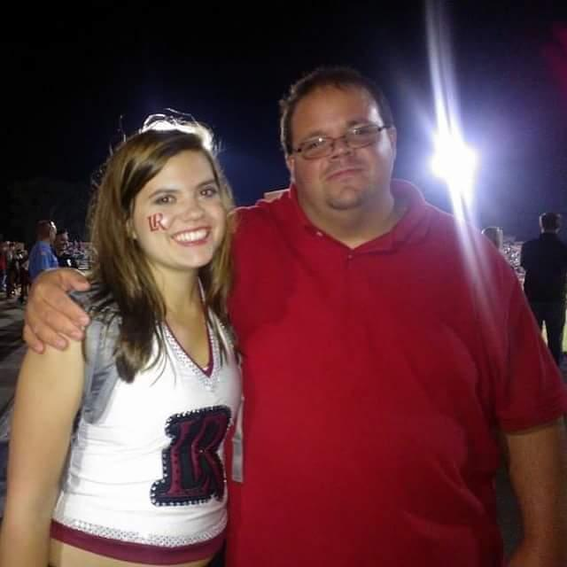
Traits
Heredity– study of how traits are passed from parent to offspring
Eye Color
Hair Color

Slide 7
Chromosomes
Chromosomes come in homologous pairs, thus genes come in pairs.
Homologous pairs – matching genes – one from female parent and one from male parent
Example: Humans have 46 chromosomes or 23 pairs, 1 set from dad – 23 in sperm, 1 set from mom – 23 in egg

Slide 8
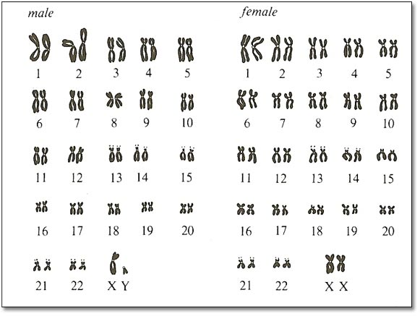
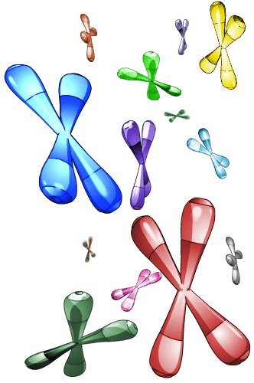
Sex Determination
Humans – 46 chromosomes or 23 pairs
22 pairs are homologous (look alike) – called autosomes – determine body traits
1 pair is the sex chromosomes – determines sex (male or female)
Females – sex chromosomes are homologous (XX)
Males – sex chromosomes are different – (XY)

Slide 9
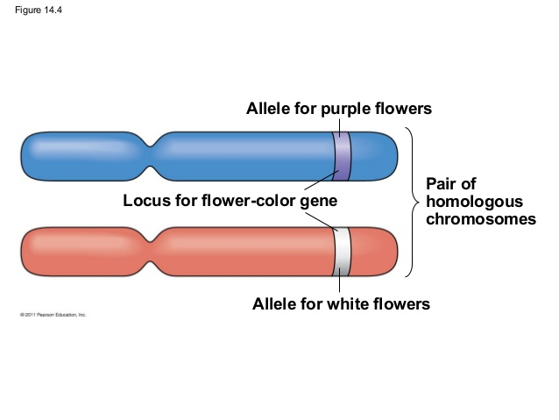
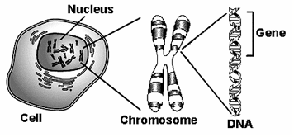
Traits are determined by the genes on the chromosomes. A gene is a segment of DNA that determines a trait.
Polygenic Traits - Controlled by many genes.
Ex: skin color, height, intelligence, and hair color

Slide 10
Homologous Chromosomes:
Gene for eye color (blue eyes)
Homologous pair of chromosomes
Gene for eye color (brown eyes)
Alleles – different genes (possibilities) for the same trait
Ex: blue eyes or brown eyes

Slide 11
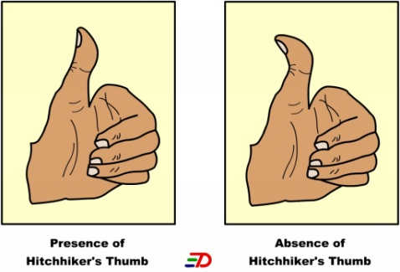
Dominant and Recessive Allele
Allele that prevents the other allele from “showing” – dominant
Allele that does NOT “show” even though it is present – recessive
Example: Straight thumb is dominant to hitchhiker thumb
T = straight thumb t = hitchhikers thumb
Straight thumb = TT
Straight thumb = Tt
Hitchhikers thumb = tt
* Must have 2 recessive alleles for a recessive trait to “show”
(Always use the same letter for the same alleles— No S = straight, h = hitchhiker’s)

Slide 12
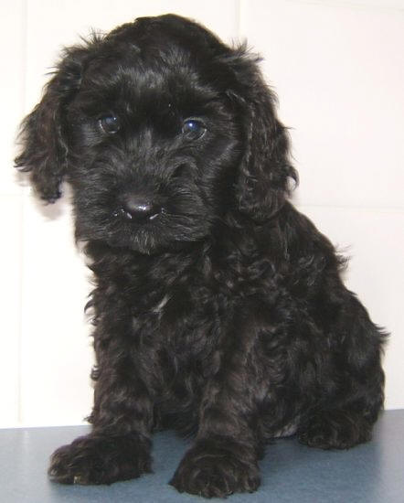
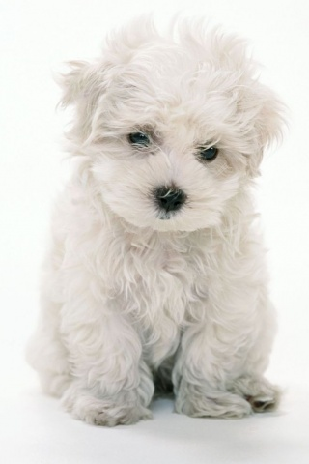
Both genes of a pair are the same –
homozygous or purebred
BB – homozygous dominant
bb – homozygous recessive
One dominant and one recessive gene – heterozygous or hybrid
Bb – heterozygous
BB – Black
Bb – Black w/ white allele
bb – White

Slide 13
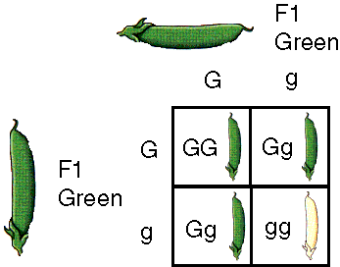
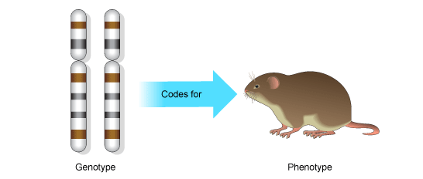
Genotype and Phenotype
Genotype - combination of genes an organism has; actual genetic makeup
Ex: TT, Tt, tt
Phenotype - physical appearance resulting from gene make-up
Ex: hitchhiker’s thumb or straight thumb

Slide 14
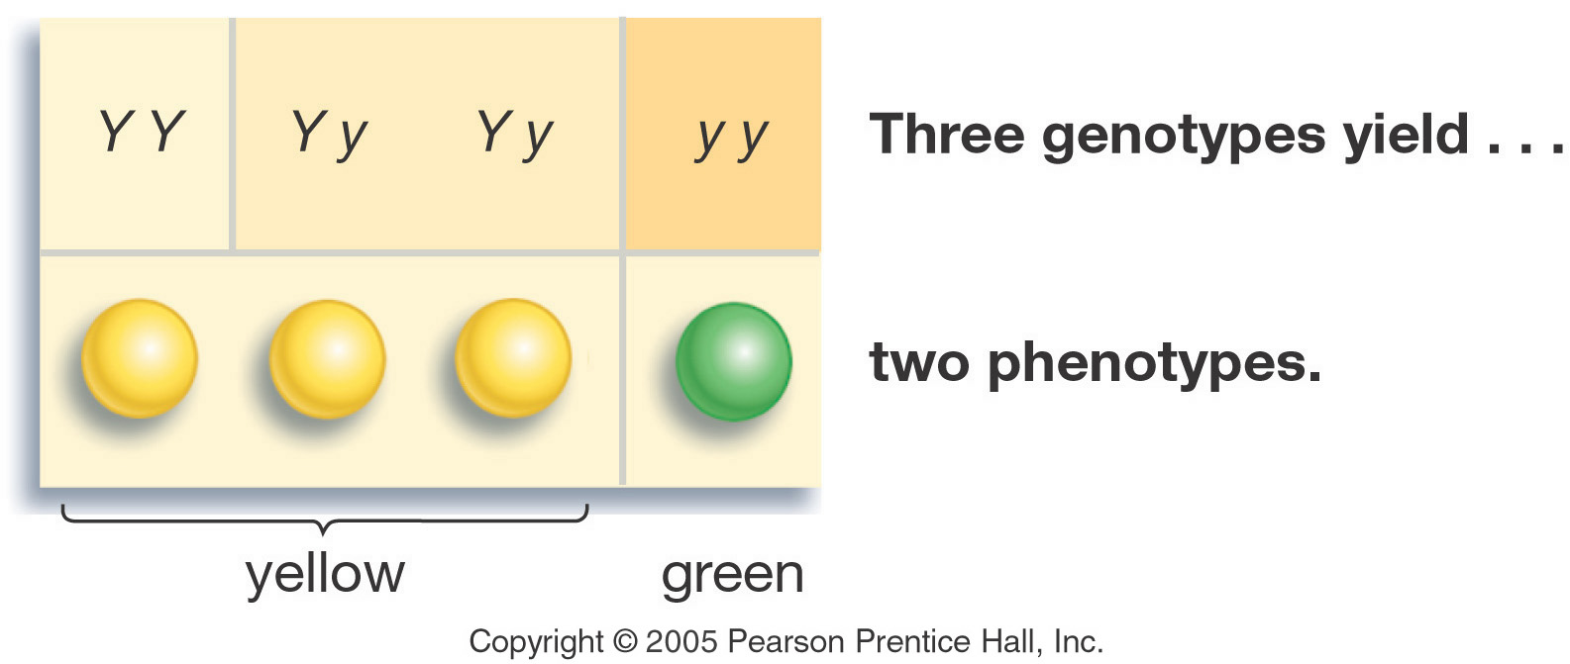
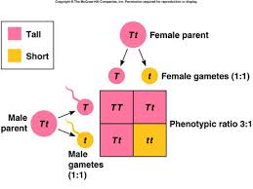
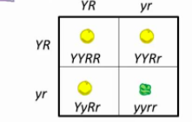
Mendel’s Laws
Principle of Dominance - 1 gene overshadows another
Law of Segregation - Alleles separate at meiosis
Law of Independent Assortment - Genes pair up independently of each other so genes for 1 trait aren’t inherited with another

Slide 15
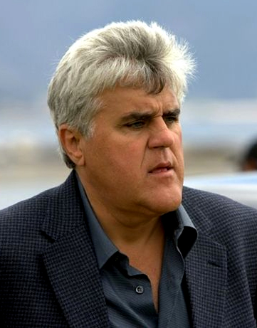
ELABORATE
MAKE A FACE LAB
Empty your chromosomes onto your table. DO NOT TURN THEM OVER. Match Homologous Chromosomes.
Using the Make a Face Packet, determine your child’s traits. Circle them on the sheet provided.
Once you have determined your child’s traits, draw their yearbook photo give them a senior quote (EACH PERSON MUST DRAW THEIR OWN)
Answer the questions on the back of your paper.
Jay Leno Chin

Slide 16
EVALUATE
Which pattern of heredity determines human hair color and skin color?
Multiple alleles
Polygenic traits
Incomplete Dominance
Codominance

Slide 17
EVALUATE
Noah has blue eyes, and both of his parents have brown eyes. What can most likely be concluded about Noah’s parents?
His father has the recessive blue eye characteristic.
B. His mother has the recessive blue eye characteristic.
C. Both of his parents have recessive blue eye characteristics.
D. Neither of his parents have the recessive blue eye characteristic.

Slide 18
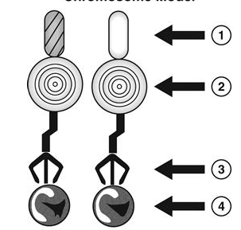
EVALUATE
A student is constructing a model of a single chromosome. The individual segments within the chromosome represent genes that control certain traits.
Based on the model, which term BEST describes gene pair #1.
Dominant
Recessive
Homozygous
Heterozygous

Slide 19
EVALUATE
Which is a homozygous genotype?
B
b
BB
Bb

Slide 20
ENGAGE
Let’s Review what we learned from Mendel and his peas…..
How could we determine the probability of pea pods being round or wrinkled?

Slide 21
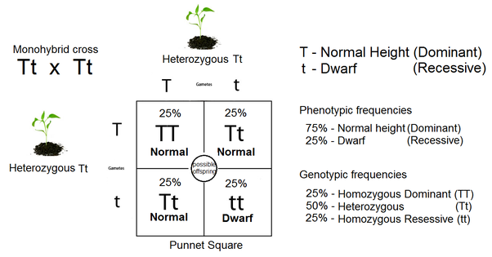
Punnett Square and Probability
Punnett Square - used to predict the possible gene makeup of offspring
Probability - The likelihood an event will occur; predicts the average outcome of a large number of events; however, it will not tell you exactly what will happen.

Slide 22
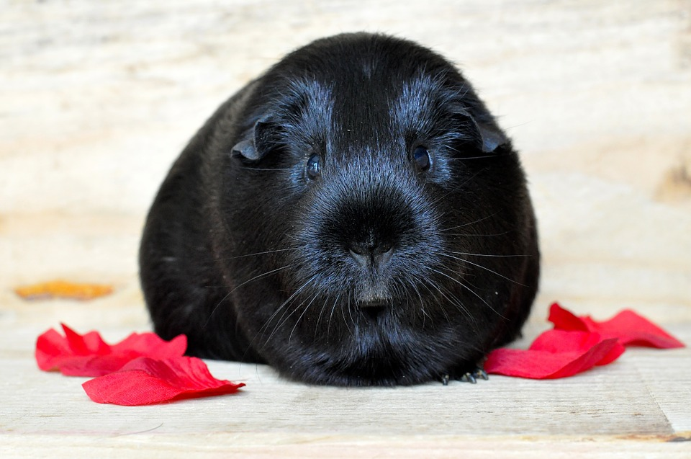
Example: Black fur (B) is dominant to white fur (b) in guinea pigs. Cross a heterozygous male with a homozygous recessive female.
What is the genotype of each parent?
Male = Bb
Female = bb
Black fur (B)
White fur (b)
Heterozygous male
Homozygous recessive female
White fur (b)
White fur (b)

Slide 23
Example: Black fur (B) is dominant to white fur (b) in guinea pigs. Cross a heterozygous male with a homozygous recessive female.
Male = Bb X Female = bb
b
b
Bb | Bb
bb | bb
B
b
Genotypic ratio = 50% Bb : 50% bb
Phenotypic ratio = 50% black : 50% white

Slide 24
Example: A man and woman, both with brown eyes (B) marry and have a blue eyed (b) child. What are the genotypes of the man, woman and child?
Bb X Bb
Man = Bb
Woman = Bb
B
b
BB | Bb
Bb | bb
B
b

Slide 25
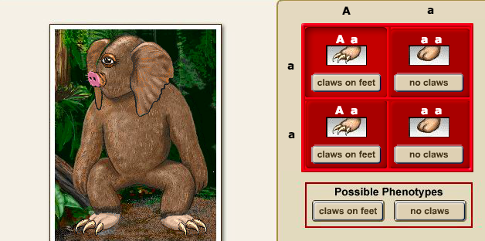
EXPLORE
Virtual Creature Lab

Slide 26
ELABORATE
Spongebob Genetics Practice

Slide 27
EVALUATE
A man who has a genotype, FF, marries a woman with the genotype, Ff. What is the probability that their offspring will have the genotype, Ff?
25%
50%
75%
100%

Slide 28
EVALUATE
If all the offspring of a test cross display a dominant phenotype, which can be determined about the individual?
The individual’s genotype will be tt.
The individual’s genotype will be TT.
The individual’s genotype will be Ttt.
The individual’s genotype will be TtTt.

Slide 29
EVALUATE
Which genotypes are possible from two heterozygous parents?
100% heterozygous
100% homozygous dominant
50% homozygous dominant, 50% homozygous recessive
25% homozygous dominant, 50% heterozygous, 25% homozygous recessive

Slide 30
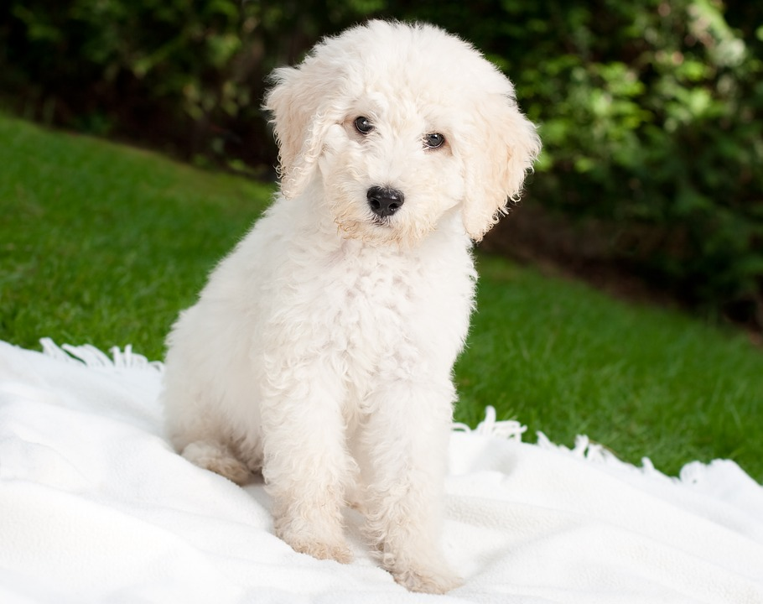
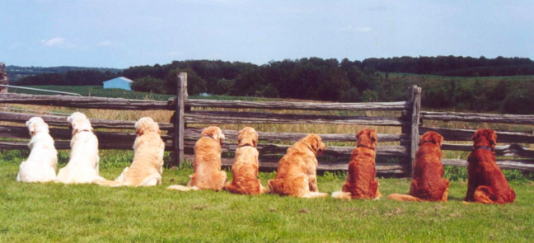
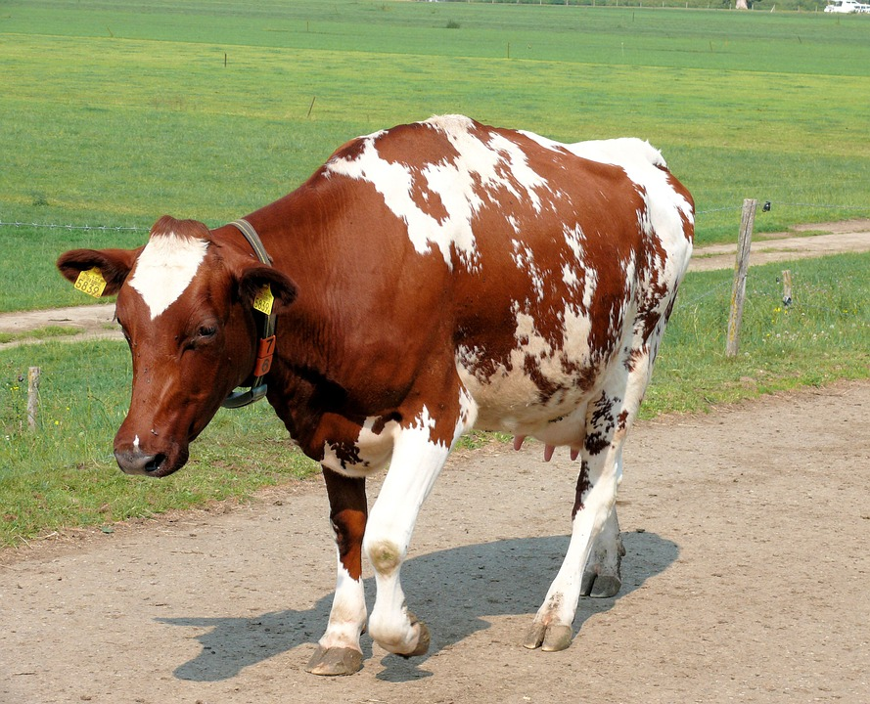
ENGAGE
We determined based on Mendelian genetics this dog is white due to having 2 recessive alleles.
What would cause these dogs to have golden fur instead of just red or white?
Or this cow to have both a red and white coat?

Slide 31
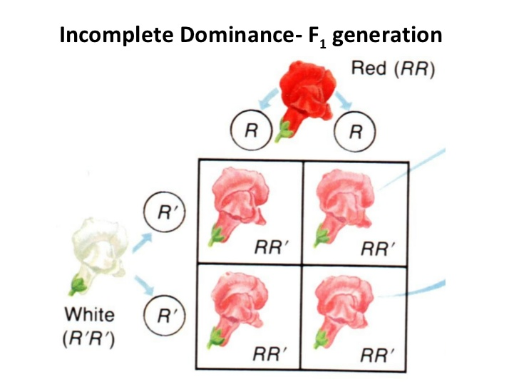
Incomplete Dominance
When one allele is NOT completely dominant over another.
F1 hybrids have an appearance somewhat in between the phenotypes of the two parental varieties.
Think pINC

Slide 32
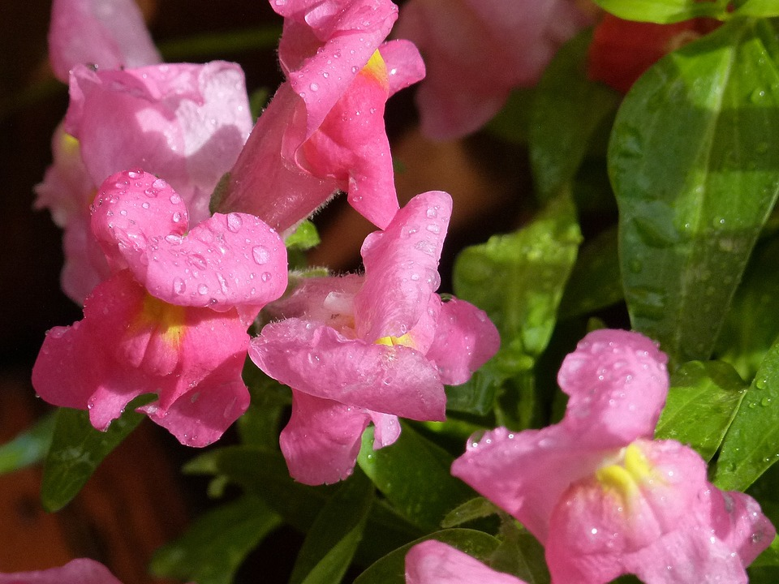
Example: A pink-flowered plant is crossed with a red -flowered plant. What is the probability of producing a pink-flowered plant?
R
R
RR | RR
RR¹ | RR¹
R
R¹
Phenotype: 2 Red
2 Pink

Slide 33
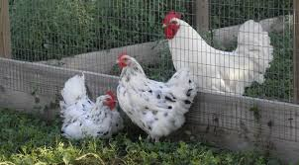
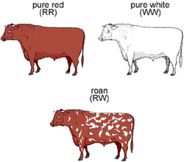
Codominance
Similar to incomplete dominance but both alleles can be distinctly seen in the phenotype.
Example: if you cross some white chickens (WW) with black chickens (BB), the offspring will be black and white chicks (BW) (“erminette”, not gray as you would expect with incomplete dominance).
Roan Cows
Think COw
Notes:
33
Mendelian Genetics
*
33

Slide 34
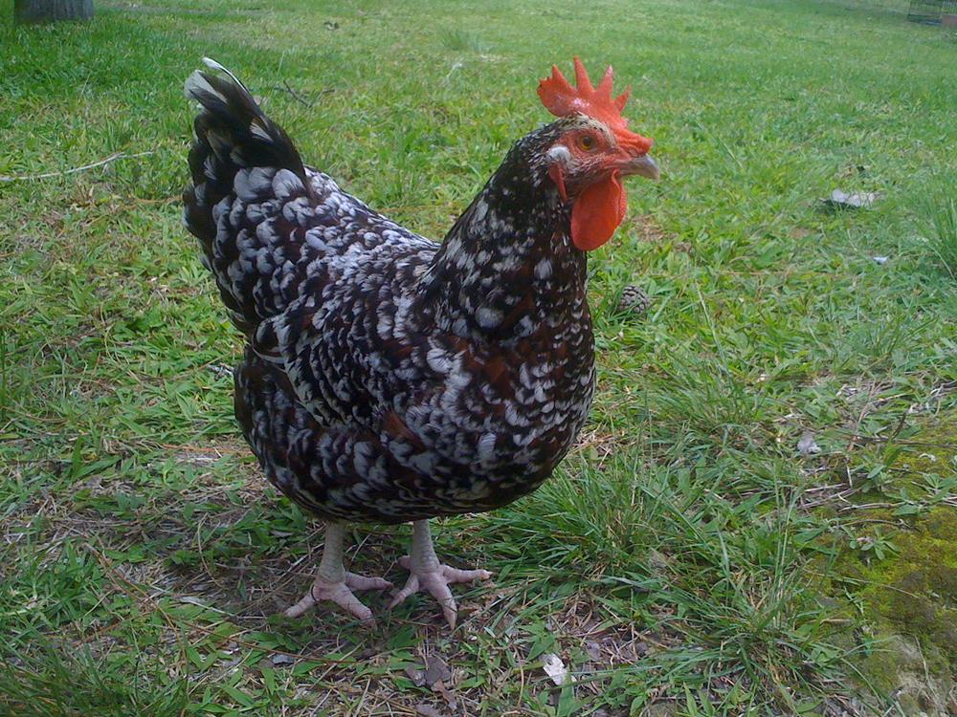
Example: A black chicken and a erminette chicken are crossed. What is the probability that they will have white chicks?
B
B
BB | BB
BW | BW
B
W
Phenotype: 2 Black
2 Erminette

Slide 35
Sex-linked Traits
There are special traits on the sex chromosomes called sex-linked traits.
Many sex-linked traits are found on the X chromosome.
Human Y chromosome is much smaller than the X chromosome and appears to contain only a few genes.

Slide 36
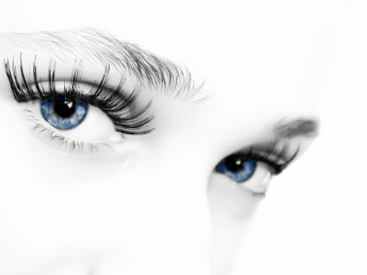
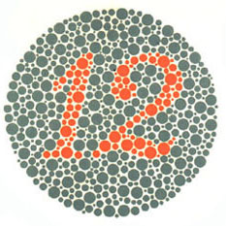
Sex-Linked Genes
Colorblindness
The most common type of colorblindness is red-green colorblindness; found in 1 in 10 males in the United States.
Since males have only one X chromosome, the X-linked traits (alleles) are expressed, even though they are recessive.
Females have two X chromosomes, so the trait is not expressed in females if they have the trait on only one X chromosome.

Slide 37
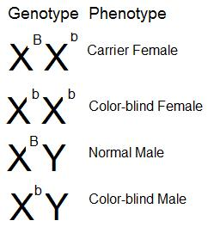
Example: A female that has normal vision but is a carrier for colorblindness marries a male with normal vision. What are the expected phenotypes of their children?
X^{B} X^{b} X X^{B}Y
X^{B}
X^{b}
X^{B}X^{B} | X^{N}X^{n}
X^{B}Y | X^{b}Y
X^{B}
Y
Phenotype: 2 normal vision females
1 normal vision male
1 colorblind male

Slide 38
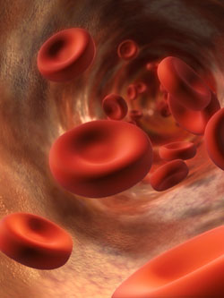
Sex-Linked Genes
Hemophilia - “bleeder’s disease” (recessive)
The body does not make a clotting factor and a person can bleed to death.
Individuals with hemophilia can be treated by injections of normal clotting proteins or blood transfusions

Slide 39
EXPLORE
Color blind Activity

Slide 40
ELABORATE
Edpuzzle - Incomplete and Codominance
Edpuzzle - Sex - Linked Traits

Slide 41
EVALUATE
A red flower (RR) and a white flower (R'R') are crossed and produce pink flower offspring (RR'). What is the expected outcome for the offspring that result from the cross between a red and a pink flower plant?
0% red, 100% pink, 0% white
25% red, 50% pink, 25% white
25% red, 25% pink, 50% white
50% red, 50% pink, 0% white

Slide 42
EVALUATE
A woman is a carrier for color blindness, a sex–linked trait. If she marries a man who is color–blind, what is the probability that one of their sons will inherit the trait?
0%
25%
50%
100%

Slide 43
EVALUATE
When a red bull (RR) is bred with a white cow (WW), a roan calf (RW) with red and white fur is sometimes produced. If a roan bull (RW) is bred with a red cow (RR), what is the most likely outcome of the offspring?
0 red : 0 white : 4 roan
1 red : 0 white : 3 roan
2 red : 0 white : 2 roan
1 red : 1 white : 2 roan

Slide 44
EVALUATE
Punnett Square Practice

Slide 45
ENGAGE
What does it mean to have Type A, Type B, Type AB or Type O blood?
Can I give blood to anyone?
Can receive blood from anyone?

Slide 46
EXPLORE
BLOOD TYPE LAB

Slide 47
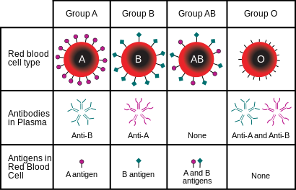
Human Genes - Blood Types
Multiple Alleles - 3 or more alleles of the same gene that code for a single trait
In humans, there are three alleles for blood types:
I^{A}, I^{B}, i
Alleles I^{A} and I^{B} are codominant.
Allele I^{A} represents blood type A
Allele I^{B} represents blood type B
Allele i is recessive
Allele i represents blood type O

Slide 48
Blood Types
Blood Type (Phenotype) | Genotype | Antigen on RBC | Donate to | Receive Blood from
A | I^{A}I^{A} or I^{A}i | A | A, AB | A, O
B | I^{B}I^{B} or I^{B}i | B | B, AB | B, O
AB | I^{A}I^{B} | AB | AB | A, B, AB, O Universal recipient
O | ii | None | A, B, AB, O Universal donor | O

Slide 49
ELABORATE
WORK ON PRACTICE PROBLEMS

Slide 50
EVALUATE
What type of inheritance controls blood types in humans?
A. incomplete dominance
B. polygenic inheritance
C. multiple alleles
D. recessive genes

Slide 51
EVALUATE
Suppose that a mother has blood Type A and genotype I^{A}i and the father has blood Type B and genotype I^{B}i. Draw a Punnett square to show the possible genotypes of their children.
What are the phenotypes of the kids?

Slide 52
EVALUATE
A man with type O blood has children with a woman who is heterozygous for type A blood. What is the probability that their children will have type A blood?
0%
25%
50%
75%

Slide 53
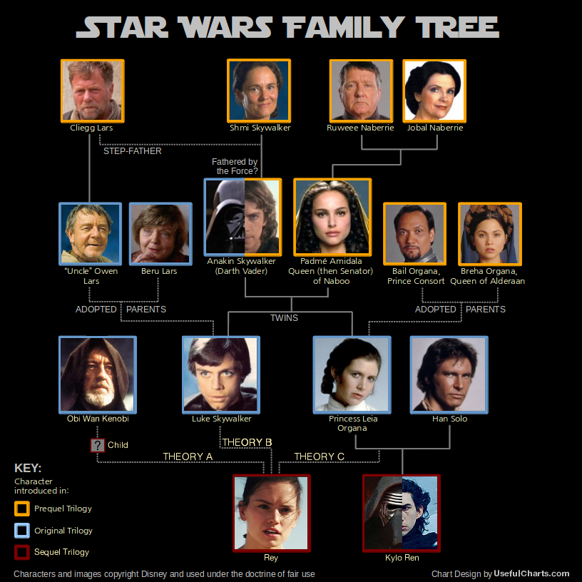
ENGAGE
We’ve discussed how to determine the probability of traits passed from out parents. However, how can we determine what traits may run through our family tree?
What do you think the lines in this pedigree show?

Slide 54
EXPLORE
PEDIGREE PROJECT

Slide 55
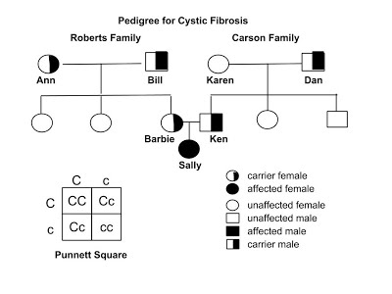
Pedigrees
Graphic representation of how a trait
is passed from parents to offspring.
Circles are for females.
Squares are for males.
Horizontal lines connecting a male and a female represent a marriage.
Vertical line and brackets connect parent to offspring.
A shaded circle or square indicates a person has the trait.
A circle or square NOT shaded represents an individual who does NOT have the trait.
Partial shade indicates a carrier – someone who is heterozygous for the trait.

Slide 56
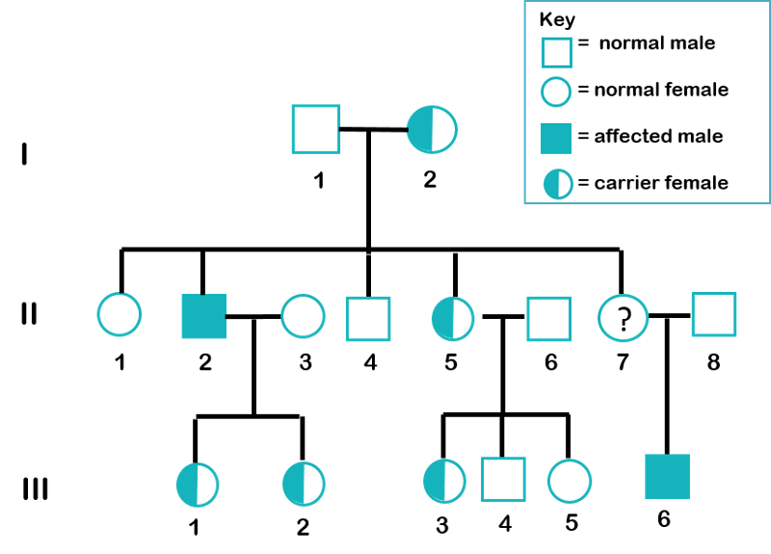
Interpreting a Pedigree
How would you determine if the pedigree chart shows an autosomal or X - linked disease?
If most of the males in the pedigree are affected, then the disorder is X-linked. If it is a 50/50 ratio between men and women the disorder is autosomal.
How would you determine whether the disorder is dominant or recessive?
If the disorder is dominant, one of the parents must have the disorder. If the disorder is recessive, neither parent has to have the disorder because they can be heterozygous.

Slide 57
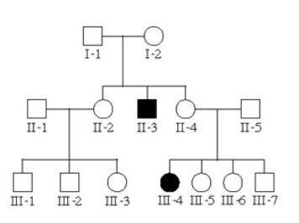
Autosomal Recessive
Trait is rare in pedigree
Appears in both sexes with equal frequency
Trait appears to “skip” generations (hidden in heterozygous parents)
Affected offspring are usually born to unaffected parents

Slide 58
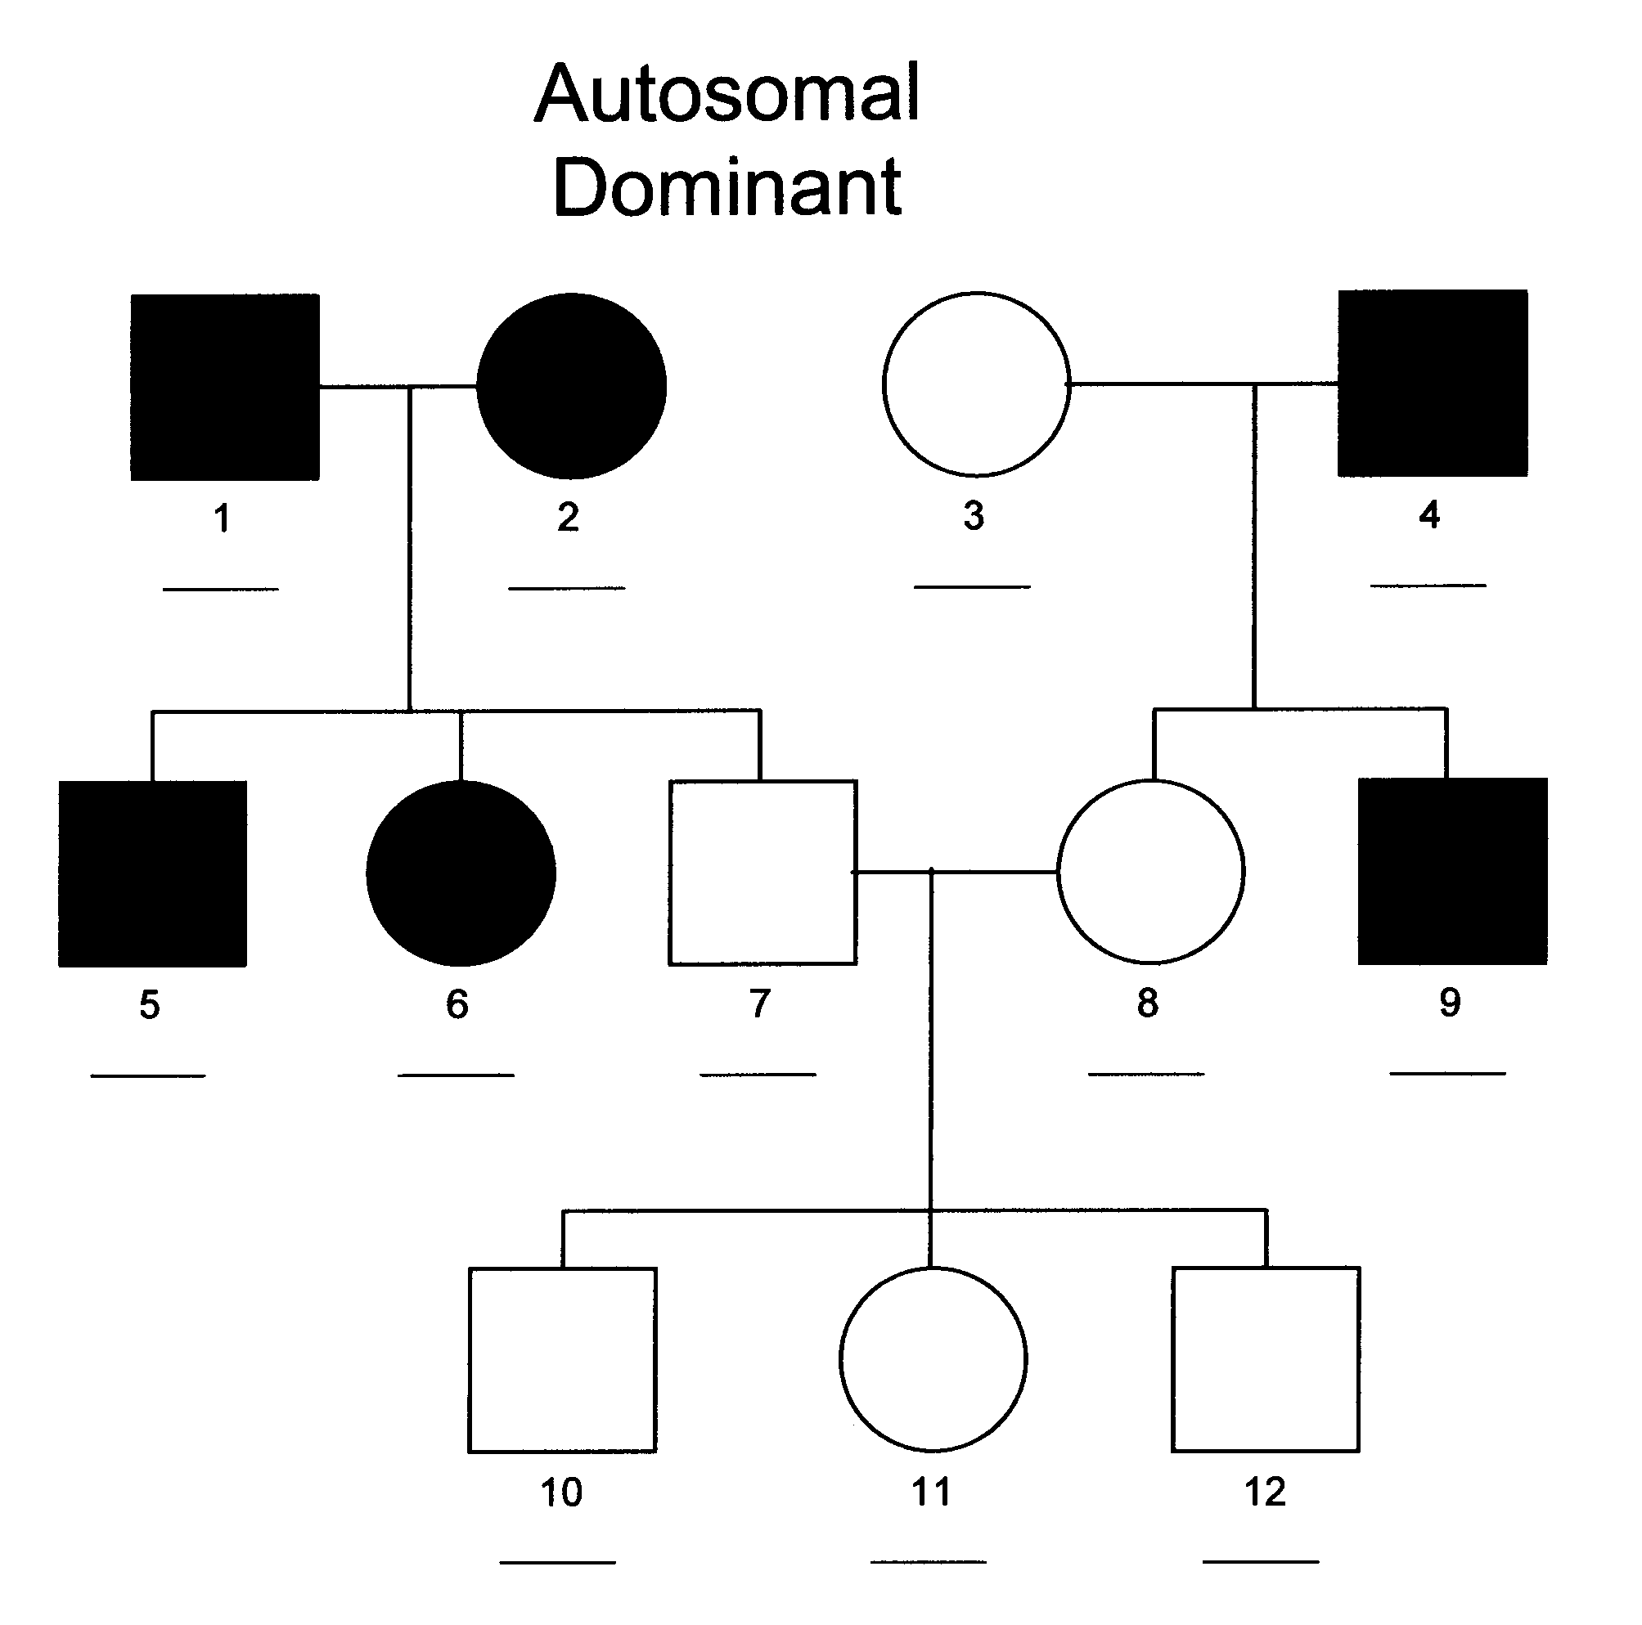
Autosomal Dominant
Appears in both sexes with equal frequency
Both sexes transmit the trait to their offspring
Does not appear to “skip” generations
Affected offspring must have an affected parent unless they posses a new mutation
Unaffected parents do not transmit the trait.

Slide 59
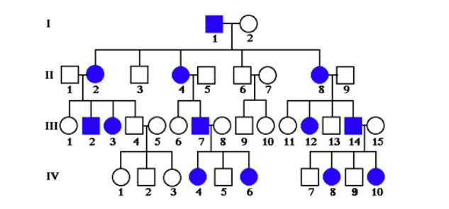
Sex - Linked Dominant
Trait is common in pedigree.
Unusual to have
Both males and females are affected
Does not appear to “skip” generations.
Affected sons must have an affected mother
Affected fathers will pass the trait on to all their daughters

Slide 60
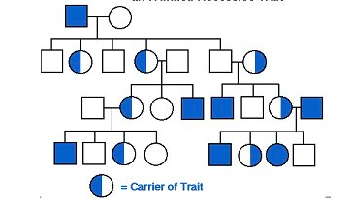
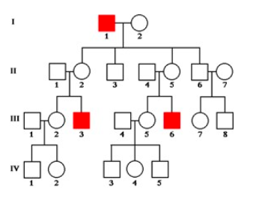
Sex - Linked Recessive
More males than females are affected; males can’t be carriers
Affected sons are usually born to unaffected mothers, thus the trait skips generations
Approximately 1/2 of carrier mothers’ sons are affected
It is never passed from father to son
All daughters of affected fathers are carriers

Slide 61
How many children did individuals I-1 and I-2 have? 6
How many girls did II-1 and II-2 have? 2
How are individuals III-2 and II-4 related? uncle/niece

Slide 62
How many members of the family above are afflected by Huntington’s Disease? 5
There are no carriers for Huntington’s Disease- you either have it or you don’t. With this in mind, is Huntington’s disease caused by a dominant or recessive trait? Dominant

Slide 63
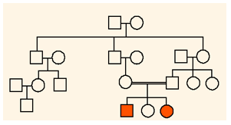
ELABORATE
PEDIGREE WORKSHEET

Slide 64
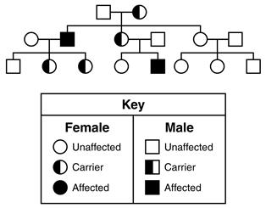
EVALUATE
Shaded individuals in this pedigree express a particular trait.
Based on this pedigree, what is the most likely pattern of inheritance of the trait?
Autosomal dominant
Autosomal recessive
Sex-linked dominant
Sex-linked recessive

Slide 65
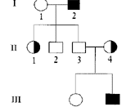
EVALUATE
The pedigree below represents a sex-linked trait in 3 generations of a family.
Which human genetic condition could best be identified using this pedigree?
PKU
Cystic Fibrosis
Hemophilia
Diabetes

Slide 66
ENGAGE
At your table, discuss the following questions:
Did you ever play the game telephone when you were a kid? What happens to the original message?
Do you think that mistakes could happen when cells are dividing or DNA is being copied?
Do you know what these mistakes are called?
Do you think it always bad? Can you think of any benefits of these errors? (sickle-cell trait, bacteria become resistant to antibiotics, etc)

Slide 67
Mutations
Mutations are changes in the DNA which can result in a change in amino acid sequence, protein function, and/or trait
Can be caused by mutagens or things in the environment that cause changes in DNA.
Exposure to chemicals, radiation, disease, and other factors.
Can happen random and spontaneously.
Only those mutations that occur in the formation of gametes can be inherited.
Can occur in 2 ways:
chromosomal mutation
gene/point mutation

Slide 68
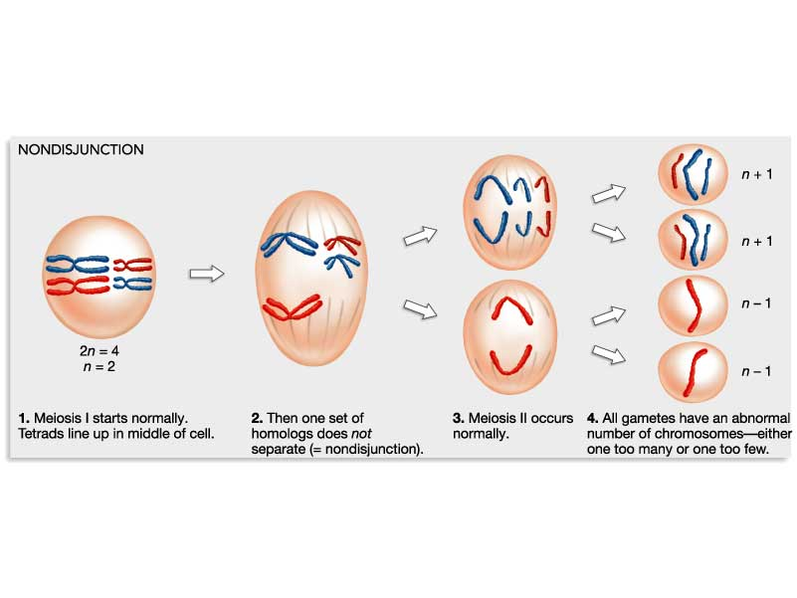
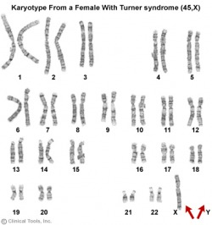
Chromosomal mutation:
less common than a gene mutation
more drastic – affects entire chromosome, so affects many genes rather than just one
caused by failure of the homologous chromosomes to separate normally during meiosis (NONDISJUNCTION)
chromosome pairs no longer look the same – too few or too many genes, different shape

Slide 69
Down’s syndrome – (Trisomy 21) 47 chromosomes, extra chromosome at pair #21

Slide 70
Gene or Point Mutation
most common and least drastic
only one gene is altered

Slide 71
Gene Mutations
Frameshift Mutations (changes entire amino acid sequence)
Deletions - Nucleotide is missing
Insertions - Nucleotide is added
Point Mutations
Substitutions - DNA is changed from one base to another

Slide 73
Mutations
Can change the amino acid sequence and thus change the protein.
Can change the function of a protein by changing the protein’s shape.
Can change the phenotype.

Slide 74
Mutations:
Can be :
Harmful mutations – organism less able to survive: genetic disorders, cancer, death
Beneficial mutations – allows organism to better survive: provides genetic variation
Neutral mutations – neither harmful nor helpful to organism

Slide 75
EXPLORE
GENETIC DISORDERS ACTIVITY

Slide 76
Autosomal Inheritance Patterns
Cystic Fibrosis - an autosomal recessive genetic disorder, caused by a mutation
Sickle Cell disease – misshapen or sickled red blood cells; resistant to malaria
Phenylketonuria (PKU) – an amino acid common in milk cannot be broken down and as it builds up it causes mental retardation

Slide 77
Dominant Gene Mutations:
Huntington’s disease – gradual deterioration of brain tissue, shows up in middle age and is fatal
Dwarfism – variety of skeletal abnormalities

Slide 78
How do environmental factors influence genetic traits?
An organism’s genotype is not the only thing responsible for the phenotype of the organism
Two factors that regulate gene expression are heredity and the environment.
Gene expression is compared to a light switch. Heredity and the environment can determine whether a gene is "turned on or off”
Example: Himalayan Rabbit

Slide 79
How do environmental factors influence genetic traits?
Some researchers believe that since identical twins have identical genotypes, any differences between them are solely due to environmental factors.

Slide 80
What environmental factors influence genetic traits for disease?
Lung/mouth cancer – tobacco use
Skin cancer – sun exposure
Diabetes – diet/exercise
Heart disease – diet/exercise

Slide 81
ELABORATE
GENETIC MUTATIONS ACTIVITY REVIEW

Slide 82
EVALUATE
What type of mutation occurs when a piece of a chromosome is lost during cell division?
Insertion
Deletion
Substitution
Iversion

Slide 83
EVALUATE
Why can differences be observed in the personalities and appearances of identical twins?
because of the expression of recessive genes
because of the impact of a chromosomal mutation
because of the impact of environment factors on gene expression
because of the expression of genes caused by incomplete dominance

Slide 84
EVALUATE
Which would most likely produce a mutation that is passed onto offspring?
radiation changing the DNA sequence in skin cells
tobacco smoke altering the genes in lung cells
exposure to chemicals altering nerve cell function
a sperm cell with a missing chromosome

Slide 85
EVALUATE
Which of these traits is most likely influenced by heredity and environmental influence?
tongue rolling
athletic performance
eye color
PTC taste

Slide 86
ENGAGE
What can you determine about an individual just by looking at this diagram?

Slide 87
EXPLORE
ONLINE KARYOTYPE ACTIVITY

Slide 88
Karyotypes
To analyze chromosomes (not alleles), scientists sometimes take pictures of the chromosomes in a cell.
They cut the chromosomes from the photograph and arrange them in groups or pairs.
Chromosomes arranged like this are called karyotypes.

Slide 89
ELABORATE

Slide 90
EVALUATE
The karyotype diagram below represents a human female with the genetic disorder known as Turner syndrome. Chromosomal analysis of this karyotype reveals the mutation is a result of
a missing X chromosome
a missing Y chromosome
an extra 21 chromosome.
missing chromosome #9

