Slide 1
What is Ecology?
Bio. 2.1 Analyze the interdependence of living organisms within their environment

Slide 2
Bio. 2.1.1 Analyze the flow of energy and cycling of matter (such as water, carbon, nitrogen, and oxygen) through ecosystems relating the significance of each to maintaining the health and sustainability of an ecosystem.

Slide 3
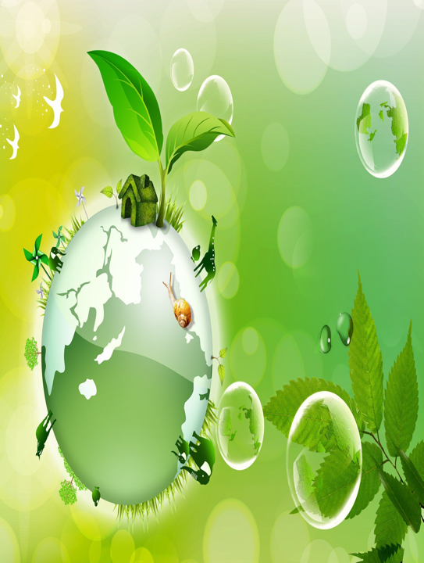
ECOLOGY
Ecology is the study of interactions among organisms and between organisms and their environment.

Slide 4
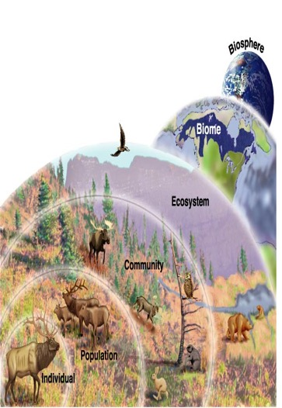
LEVELS OF ORGANIZATION
Atom - all matter
Molecule - atoms come together
Cell - life begins
Tissue - cells work together
Organ - heart, lungs, kidneys
System - nervous, circulatory, respiratory
Organism/Species – breed and produce fertile offspring
Population – belonging to the same species
Community – different populations that live together in a defined area
Ecosystem – all the living organisms in an area and the nonliving factors that affect them
Biome – a group of ecosystems with the same climate and similar dominant community
Biosphere – combined portions of the planet in which all life exists

Slide 5
LIFE DEPENDS ON THE SUN
Radiant energy enters an ecosystem when plants use sunlight to make sugar molecules. This radiant energy is converted to chemical energy and allows organisms to carry out life processes.
Photosynthesis is the process by which plants, algae, and some bacteria use sunlight, carbon dioxide, and water (inorganic) to produce carbohydrates (organic) and oxygen.

Slide 6
CELLULAR RESPIRATION
An organism obtains energy from the food it eats.
The process of breaking down food to yield energy is called cellular respiration.
Through cellular respiration, cells use glucose (sugar) and oxygen to produce carbon dioxide, water, and energy.

Slide 7
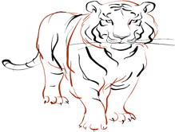
FROM PRODUCERS TO CONSUMERS
Organisms that make their own food, through photosynthesis or chemosynthesis, are called producers or autotrophs.
Organisms that get their energy by eating other organisms are called consumers or heterotrophs.
Types of Producers:
Grass, Algae, and Trees
Types of Consumers:
Herbivores
Carnivores
Omnivores
Decomposers (break down organic matter)
Scavengers (eat dead organisms)

Slide 8
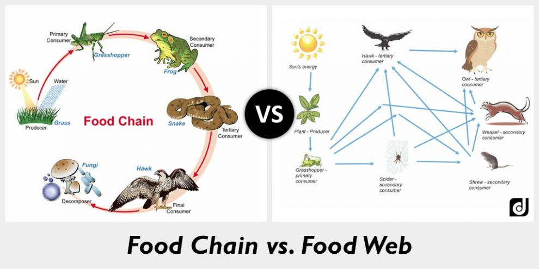
FOOD CHAIN AND FOOD WEB
A food chain is a series of steps in an ecosystem in which organisms transfer energy to each trophic level by eating and being eaten. A food web is an interconnected group of food chains.
Since Radiant energy Chemical energy Heat Energy, continuous refuel of radiant energy is required.

Slide 9
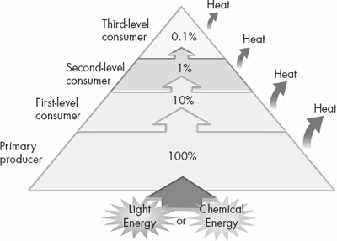
ENERGY PYRAMID
Producers form the base of the energy pyramid, and therefore contain the most energy.
Only about 10% of energy is transferred between each trophic level as the rest (90%) is lost as heat energy.
The pyramid becomes smaller toward the top, where less energy is available.
Highest biomass is at the bottom.
Notes:
9

Slide 10
BIOGEOCHEMICAL CYCLE
WATER CYCLE
CARBON CYCLE
NITROGEN CYCLE
PHOSPHOROUS CYCLE
Notes:
10

Slide 11
WATER CYCLE
Precipitation: water moves from atmosphere to Earth’s surface
Evaporation: water moves from Earth’s surface to atmosphere
Runoff: water moves to lowest point, due to gravity
Infiltration: water seeps through soil to become groundwater
Transpiration: water evaporates from leaves
Condensation: water vapor cools and condenses to form water droplets that make clouds

Slide 12
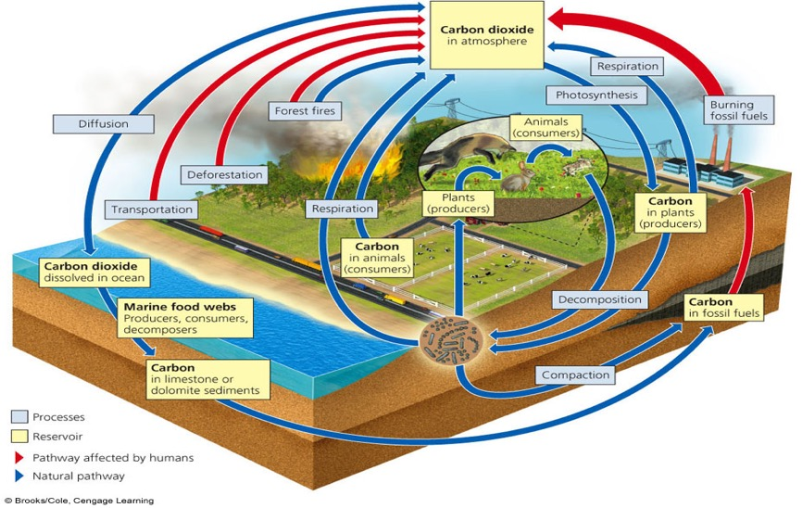
CARBON CYCLE

Slide 13
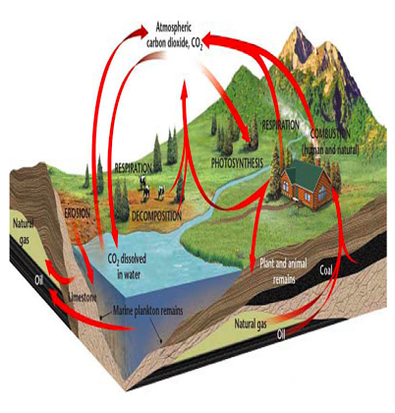
CARBON CYCLE
Carbon exists in air, water, and living organisms.
Organisms use carbon to make organic compounds
(carbohydrates, lipids, proteins, and nucleic acids).
Carbon stored in the bodies of organisms as fat, oils, or other molecules, may be RELEASED into the soil or air when the organisms dies.

Slide 14
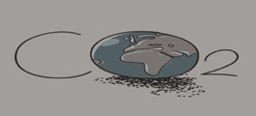
CARBON CYCLE
Plants (photosynthesis) and the ocean help DECREASE the amount of carbon in the atmosphere.
Cellular respiration, decomposition, combustion (burning of fossil fuels), volcanic activity, deforestation, and erosion RELEASE carbon dioxide.
Burning of fossil fuels leads to increased levels of carbon dioxide in the atmosphere. Carbon dioxide is a greenhouse gas, which effectively retains heat, increasing global temperatures.
Therefore, BURNING FOSSIL FUELS contributes to GLOBAL CLIMATE CHANGE by increasing levels of carbon dioxide

Slide 16
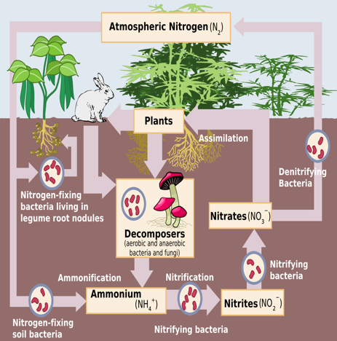
NITROGEN CYCLE
Nitrogen fixation: bacteria, algae or lightning convert nitrogen gas into ammonia
Nitrification: bacteria convert ammonia to nitrates
Nitrogen uptake: plants absorb nitrogen (nitrates) from the soil to make Decomposition: removes nitrogen from dead organisms and returns it to the soil
Denitrification: bacteria transfer nitrogen from soil to atmosphere
NITROGEN PLAYS A KEY ROLE IN THE MAKING OF PROTEINS.

Slide 17
Bio 2.1.3 Explain various ways organisms interact with each other (including predation, competition, parasitism, mutualism) and with their environments resulting in stability within ecosystems.

Slide 18
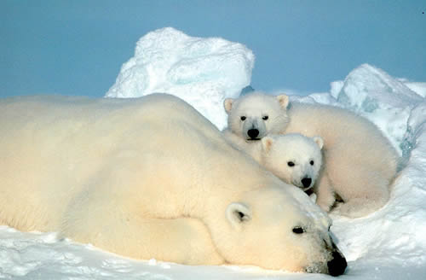
SHAPING AN ECOSYSTEM
Biotic and Abiotic Factors
Climate
Habitat and Niche
Community Interactions
Competition
Predation
Symbiotic Relationships

Slide 19
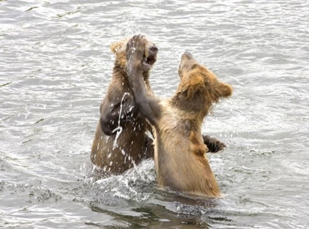
BIOTIC FACTORS
Biological influences on organisms are called biotic factors or biota.
Examples:
Plants
Animals
Fungi
Bacteria
Microorganisms

Slide 20
ABIOTIC FACTORS Physical, or nonliving, factors that shape ecosystems.
Terrestrial Ecosystems
Aquatic Life Zones
Light penetration
Water currents
Dissolved nutrient concentrations (nitrogen and phosphorus)
Sunlight
Temperature
Precipitation
Wind
Latitude
Altitude
Soil

Slide 21
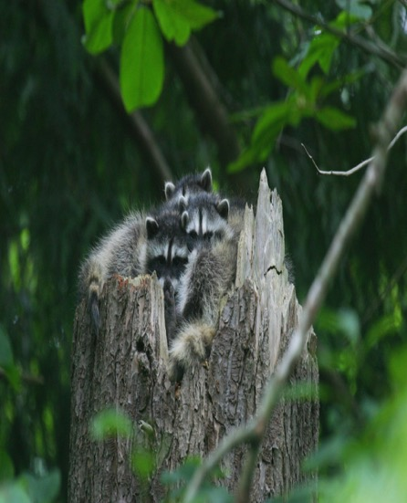
HABITAT AND NICHE
Habitat – area where an organism lives
Ecological niche –it is the organism’s “job”
Competitive Exclusion Principle - 2 species can’t occupy same niche at same time.
Notes:
21

Slide 22
CLIMATIC FACTORS
Climate is the most important factor in determining where an organism can live.
Climate is the average, year-after-year conditions of temperature and precipitation in a particular area
Climate factors that must be considered are:
Sunlight
Temperature
Precipitation
Wind currents
Latitude
Climate can be influenced by both human activity (global warming) and natural processes such as volcanic activity.

Slide 23
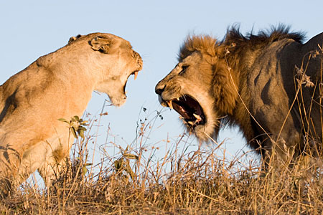
COMPETITION
Competition occurs when organisms of the same or different species attempt to use the same resource:
Food, water, nutrients, shelter, space, or sunlight
May exhibit behaviors such as:
Aggression (snarl, bark, hiss)
Territorial (protect and guard)

Slide 24
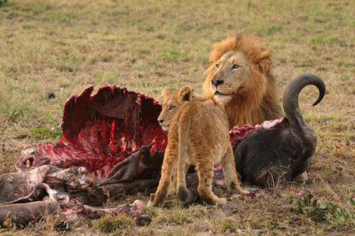
PREDATION
Predation is the consumption of one species (the prey) by another (the predator).

Slide 25
SYMBIOTIC RELATIONSHIPS
Symbiotic relationships - two species live closely together.
Mutualism
Both partners benefit
Insects and flowers
Commensalism
One partner benefits and the other is unaffected
Barnacles attached to a whale’s skin
Parasitism
One partner benefits (parasite) while the other is harmed (host)
Fleas, ticks, and lice

Slide 26
Bio. 2.1.4 Explain why ecosystems can be relatively stable over hundreds or thousands of years, even though populations may fluctuate (emphasizing availability of food, availability of shelter, number of predators and disease).

Slide 27
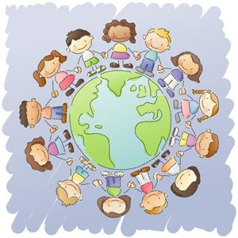
POPULATION DYNAMICS
A population is a group of members of the same species, living in a defined area at the a specific time
Examples: the human population, the dog population, the bacterial population

Slide 28
FACTORS THAT CHANGE POPULATION SIZE
There are four factors that produce changes in population size:
Natality – birth rate
Mortality – death rate
Growth rate (r) is the rate of change of a population over a specific time
r = b – d (growth rate = natality – mortality)
Immigration – an individual enters the population
Emigration – an individual leaves the population

Slide 29
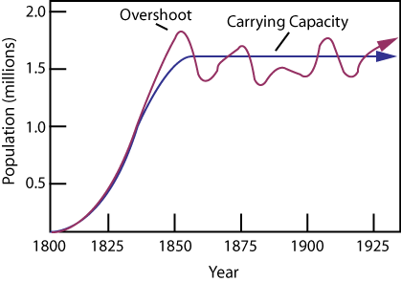
CARRYING CAPACITY
Carrying capacity is the largest population that can be maintained for an indefinite period by a particular environment that is not undergoing change
Exponential population growth
J-shaped curve

Slide 30
FACTORS LIMITING POPULATION GROWTH
Limiting Factors – Factors that influence the population of any organism
Density-dependent factors are those that affect a large proportion of the population as the population density rises.
Predation or parasitism
Disease
Competition
Density-independent factors are those that limit population growth, but are not influenced by changes in population density.
Natural disasters
Seasonal cycles
Human activities

Slide 31
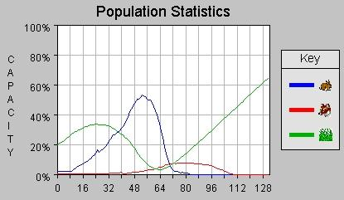
1 What happened to the rabbit population when the wolf population increased? Why?
2. What happened to the grass population when the rabbit population increased? Why?
3. What will happen to both the grass and wolf population now that the rabbits are dead?

Slide 32
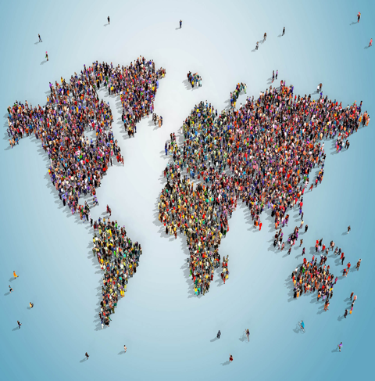
HUMAN POPULATION
Humans are unique in that they have much more control over factors in their ecosystems.
Disease was the “limiting factor” for many years and the human population stayed at a low carrying capacity.

Slide 33
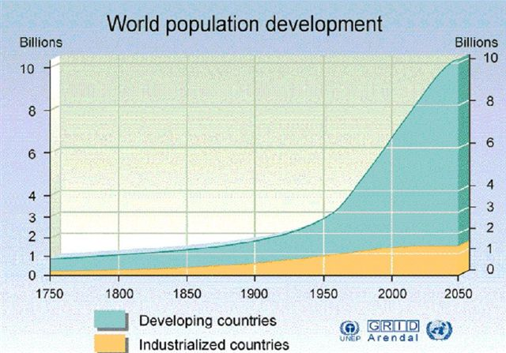
WORLD POPULATION

Slide 34
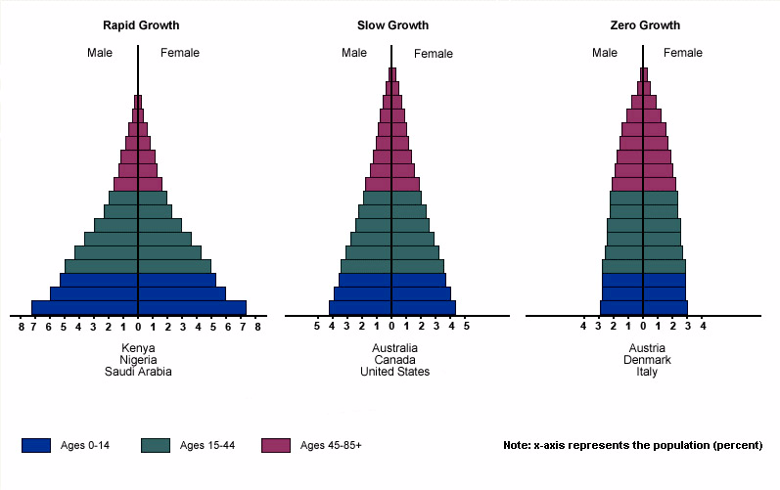
AGE STRUCTURE DIAGRAM
Age structure is the number and proportion of people at each age in a population

Slide 35
Bio. 2.2 Understand the impact of human activities on the environment (one generation affects the next).

Slide 36
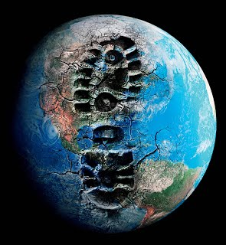
HUMAN IMPACT ON THE ECOSYSTEM
Ozone Depletion
Deforestation
Global Climate Change
Bioaccumulation
Artificial Eutrophication
Pollution
Acid Rain
Beach Erosion
Population Growth and Urban Development
Waste Lagoons (Hog Farms)
Species Introduction – Invasive Species
Habitat Fragmentaion
Water Runoff

Slide 37
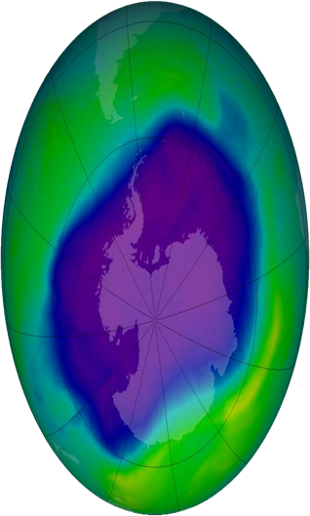
OZONE DEPLETION
Caused by the use of coolants and aerosol cans.
(CHLOROFLUOROCARBONS - CFC)
Effects include increased UV radiation, skin cancer and eye disorders

Slide 38
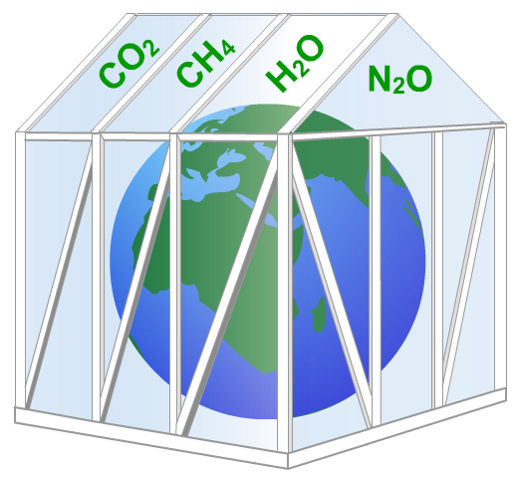
GLOBAL CLIMATE CHANGE
One of the greatest threats caused by air pollution is global warming. Global warming is caused by a build-up of greenhouses gases, which leads to an increase in the Earth’s temperature. Other effects include bizarre weather patterns, and melting of polar ice caps
Key greenhouses gases include:
carbon dioxide
methane
water vapour
nitrous oxide
Notes:
38

Slide 39
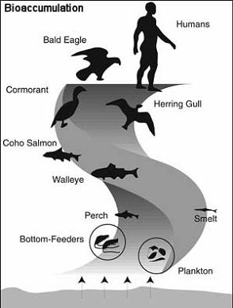
BIOACCUMULATION
When an organism does not metabolize or excrete a long-term toxin, it gets stored, usually in fatty tissue. Over time the organism may accumulate more and more of the toxin. This is called bioaccumulation.
Organisms at higher trophic levels, tend to store greater amounts of the toxins. The increase in concentration as the toxin passes through successive levels of the food web is known as biological magnification.
Notes:
39

Slide 41
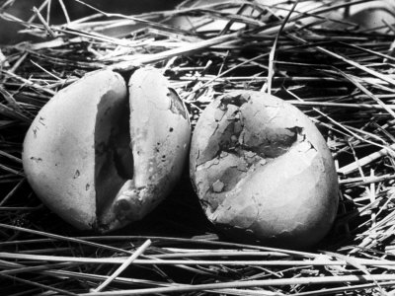
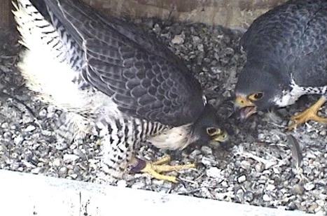
BIOACCUMULATION - DDT
DDT was used as a very effective pesticide in the 1980s, until it was determined that due to bioaccumulation, bird populations had great quantities of DDT in their bodies.
Result of increased DDT levels led to thin eggshells that broke, killing the embryo; saw birds of prey populations decrease

Slide 42
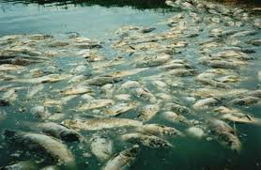
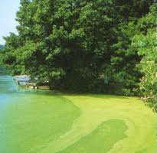
ARTIFICIAL EUTROPHICATION
Eutrophication – refers to the "bloom" or great increase of phytoplankton in a water body due to the addition of nitrates or phosphates from fertilizers or sewage
Excess fertilizer and animal waste runoff are carried into streams, rivers, and lakes. These nutrients allow algal blooms to occur. As the algae dies and decays, it removes oxygen from the water, killing the fish and creating dead zones.

Slide 43
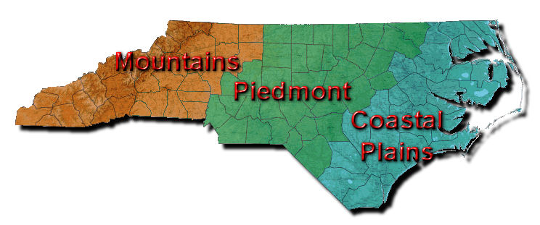
IMPACTS ON NORTH CAROLINA ECOSYSTEMS
Acid Rain (Mountains)
Urban Development (Piedmont)
Beach Erosion (Coast/Tidewater)

Slide 44
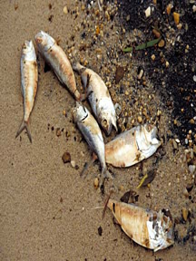
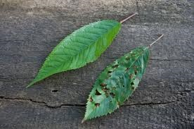
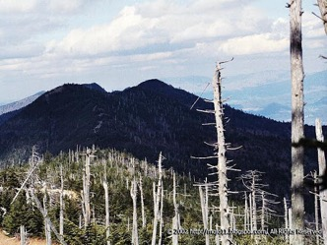
ACID PRECIPITATION
Acid precipitation is any form of precipitation (snow, rain, sleet, and fog) that become acidified (low pH).
Cause = coal burning factories (sulfur dioxides), car exhaust, etc.
Effect = damage to plant tissue aquatic species
Mt. Mitchell

Slide 45
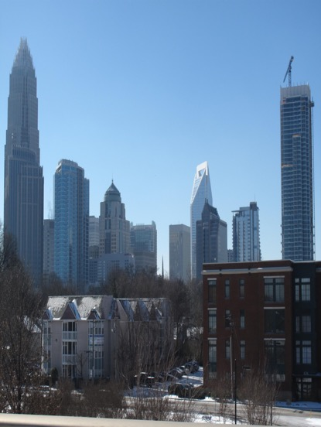
URBANIZATION DUE TO HUMAN POPULATION GROWTH
Human population growth is exponential.
As a result, we need more space to live, which results in deforestation to make homes.
We generate more waste (pollution) and consume more resources.
We generate better quality of life through new technology (mass production, pesticides, gas engines, etc), which leads to burning of fossil fuels and air and water pollution.

Slide 46
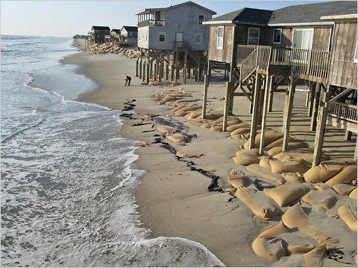
BEACH EROSION
More humans = more space to live
Build on beaches, but they constantly erode
Must artificially sustain beaches through beach nourishment projects
Sandbags to prevent loss of sand

Slide 47
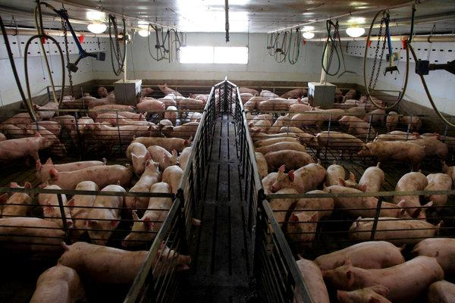
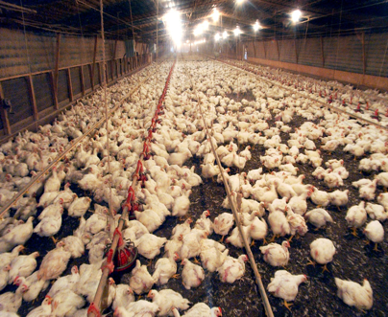
HABITAT DEGRADATION - WASTE LAGOONS
NC has lots of hog and poultry farms and utilizes concentrated animal feeding operations (CAFO-lots of animals in close quarters) for maximum efficiency in food processing
All of those animals = LOTS of waste….where does it go?

Slide 48
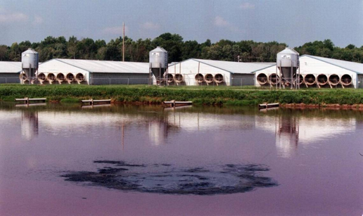
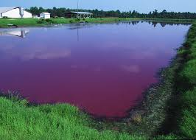
HABITAT DEGRADATION - HOG FARMS
Waste collects in a lagoon outside hog house; when it rains and the lagoon overflows, water mixed with waste flows into nearby streams(Pfiesteria).

Slide 49
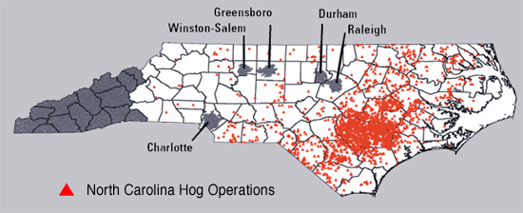
HABITAT DEGRADATION - HOG FARM

Slide 50
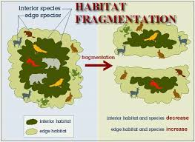
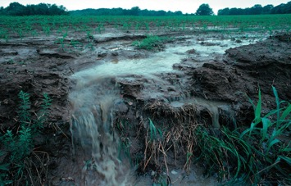
MORE NC IMPACTS
Habitat Fragmentation – dividing up ecosystems for progress
Water Runoff

Slide 51
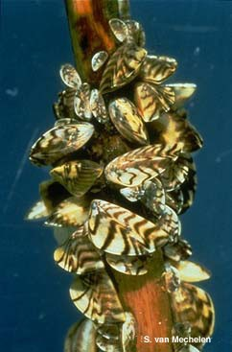
INVASIVE SPECIES
An invasive species is a nonnative species whose introduction causes or is likely to cause economic or environmental harm.
Can be an animal, plant, or microbes
Detrimental to ecosystem…why?

Slide 52
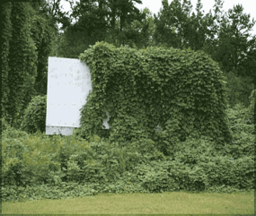
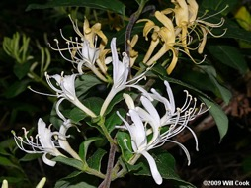
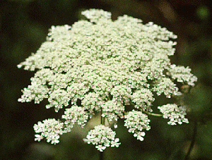
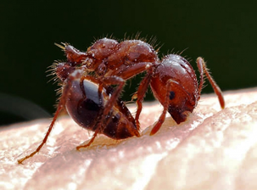
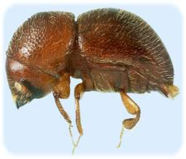
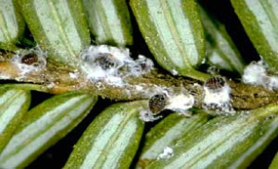
INVASIVE SPECIES IN NC
Plants: Kudzu, Japanese Honeysuckle, Chinese privet
Animals: Hemlock woolly adelgid, Ambrosia beetle, Fire Ant

Slide 53
CONSEQUENCES FOR LOSS OF BIODIVERSITY
Extinction – disappearance of a species when the last of its members dies; current rate of extinction has accelerated
Ecosystem collapse – if keystone species is removed, the entire ecosystem could collapse (ex: sea otter in kelp forests)
Loss of medicinal cures for diseases – unknown how many or what types of plants could contribute to medicine
Many ecosystems are so complex that ecologists cannot begin to predict ramifications of biodiversity loss

Slide 54
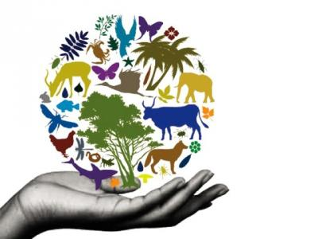
HOW TO PROTECT BIODIVERSITY
Conservation biology
Legislation
Preserving Habitats
Reintroduction and Captive Breeding Programs
Reducing “ecological footprint”
Proper farming practices

Slide 55
WAYS TO PROTECT THE ENVIRONMENT
ACTION | EFFECT
Reduce, reuse, and recycle | Reduces waste, reduces burning, reduces use of raw materials to make products
Use fuel-efficient vehicles | Reduces acid rain, reduces global warming, reduces dependency on oil
Conserve electricity and water | Reduces use of fossil fuels, protects fresh water resources
Grow and buy organic food | Reduces use of chemical fertilizers and pesticides
Public transportation / drive less | Reduces air pollution and protects natural resources

Slide 56
Threat | Cause | Effect
Global Warming | Burning fossil fuels and losing forests | Changes in climate, melting of polar ice, drought, flooding
Acid Rain | Burning fossil fuels | Destruction of forests, poison lakes, dead wildlife, damaged buildings
Ozone Depletion | CFC’s chlorofluorocarbons | More skin cancer, mutations
Air Pollution | Burning fossil fuels and wood | More diseases
Water Pollution | Waste, heat, chemicals | Dead wildlife, loss of drinking water, loss of irrigation water
Soil Degradation and Depletion | Erosion, overuse, pesticides | Loss of agriculture, dead wildlife
Habitat Destruction | Poisoned lakes, cut forests | Dead wildlife, upset balance of nature

