Slide 1
Biotechnology

Slide 2
ENGAGE
Agricultural and bio-related technologies are involved in all aspects of living organisms.
How do you think these technologies have impacted our environment, culture, and society?
FOOD SAMPLE STATIONS

Slide 3
EXPLORE
BIOTECHNOLOGY WEBQUEST

Slide 4
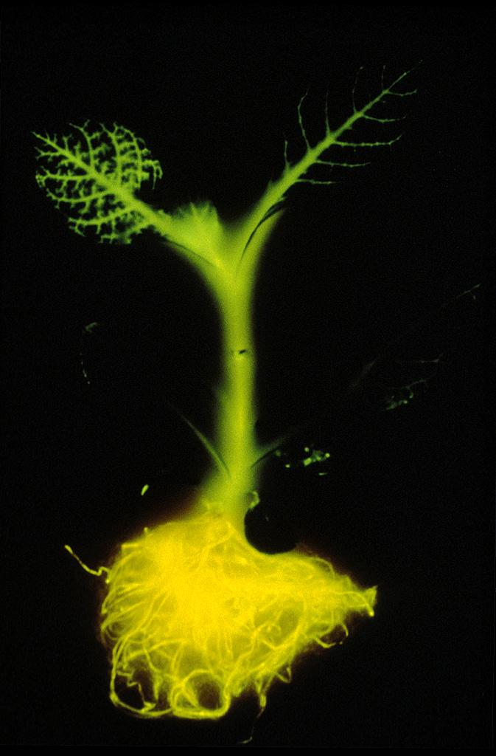
Biotechnology
Biotechnology is the use of organisms to benefit humanity
Biotechnology business in the United States brings in about $40 billion
North Carolina ranks third in the United States in biotechnology companies.
Biotechnology companies specialize in fields like agriculture, gene therapy, pharmaceuticals and forensics.
Genetically engineered tobacco plant with the luciferase gene from a firefly inserted.

Slide 5
Biotechnology
Today much of biotechnology includes genetic engineering.
This involves modifying DNA to produce new genes (new traits) in organisms
Recombinant DNA is DNA is formed by the splicing of DNA from two different species; the DNA from one organism is inserted and combined with the DNA of another organism
You “recombine” an organism’s DNA.

Slide 6
Applications of Biotechnology
Agricultural Applications
Transgenic animals are those that contain the gene of another animal
Scientists remove an egg and fertilize it in vitro
They inject cloned DNA from another organism into the nucleus of the fertilized egg
Some cells take up the transgene and incorporate it in the embryo
The embryo is implanted in a surrogate mother
The embryo grows into a transgenic animal.

Slide 7
Applications of Biotechnology
Genes that have been inserted might cause the animal to:
Increase muscle growth (more meat)
Grow more wool
To make certain drugs or chemicals
The drugs or chemicals can easily be purified from animal products like milk or blood
These animals are called “pharm” animals (pharmaceutical animals)

Slide 8
Cloning
Cloning - introduction of the nucleus from a body cell into an empty egg cell to generate an organism identical to the nucleus donor
Clone- a member of a group of genetically identical cells
May be produced by asexual reproduction (mitosis)

Slide 9
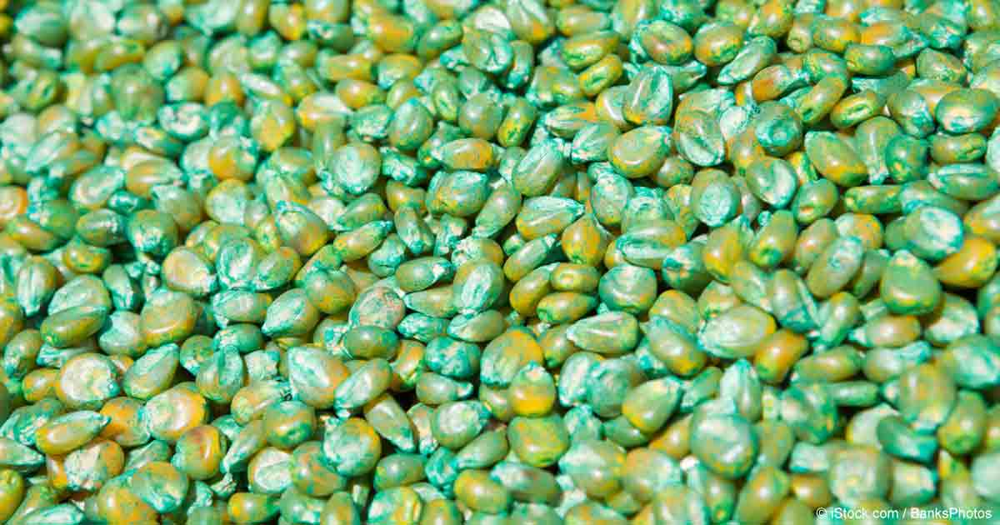
Applications of Biotechnology
Transgenic plants have also been manufactured
Golden rice contains very high amounts of vitamin A (beta carotene). It could be used to help people who suffer from this deficiency (50% of the world)
Some plants have been engineered that:
Contain genes resistant to herbicides like Roundup
Increase the amount of starch or sugar in the seed
Change the colors or color-pattern of flowers and leaves

Slide 10
Applications of Biotechnology
Medical Applications
Human gene therapy
Gene therapy is altering an afflicted individual’s genes
A “normal” gene is inserted into the somatic cells to correct the disorder

Slide 11
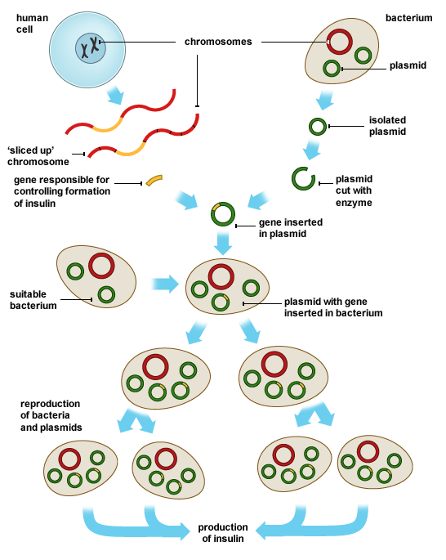
Applications of Biotechnology
Pharmaceutical Products
Human insulin and human growth hormone were manufactured by inserting a gene in bacterial plasmids, which then manufactured these materials.
Bacterial Transformation

Slide 12
Bacterial Transformation
Several procedures involved in bacterial transformation are listed below.
1. A specific gene of interest is identified in DNA.
2. The DNA fragment of interest is isolated.
3. A plasmid is cut by a restriction enzyme.
4. The DNA fragment is placed in a plasmid.
5. The plasmid is transferred to a bacterial cell.

Slide 13
Applications of Biotechnology
Forensic evidence
The analysis of DNA extracted from an individual, which is unique to that individual is DNA typing
DNA fingerprinting or DNA profiling
DNA fingerprinting can be used to:
Identify criminals
Identify mass disaster victims
Track contaminated food
Determine ancestry
Establish paternity
Determine the path of an epidemic

Slide 14
GEL ELECTROPHORESIS
a tool used in DNA fingerprinting
Restriction enzymes cut DNA at a particular base sequence. This results in longer and shorter sections of DNA.
The sections of DNA are put in a gel and an
electrical current pulls the segments through the gel.
The longer segments do not travel as far as the shorter segments. Since each individual is different, this creates a different DNA fingerprint for each person !

Slide 15
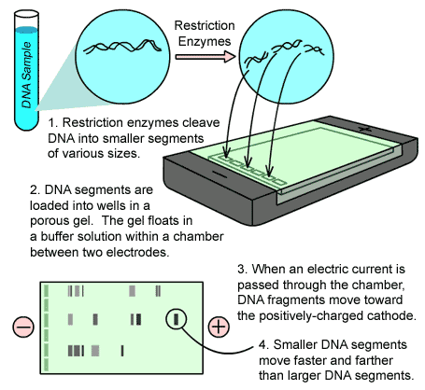
Gel Electrophoresis

Slide 16
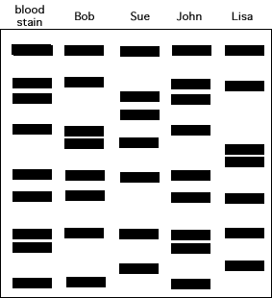
Example 1:
Police were called to the residence of a local cat farmer. Several of his cats were stolen during the night. The CSI team collected what they believed to be a sample of blood from the thief.
The main suspects were ;
Bob, the builder,
Sue, the house cleaner,
John, the litter box changer, and
Lisa, the biology teacher who hated cats.
Use the DNA fingerprint to determine who is the thief.

Slide 17
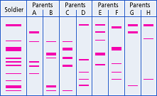
Example 2: Who are the parents of this soldier? How do you know?

Slide 18
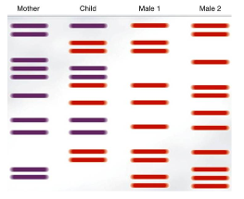
Example 3: Who is the dad?

Slide 19
Biotechnology Provides:
Improved food products
Medical advances
An enhanced environment

Slide 20
Environmental Benefits
Reduced pesticide use
Lower energy requirements
Cleaner water
Less soil erosion

Slide 21
Human Genome Project
In 1990, the Human Genome Project was started
The goal of this project was to map the entire genetic makeup of humans; which contain about 3 billion base pairs
The process was completed in 2001, after an automated process based on the chain termination method was developed
Since that time many other organisms’ genomes have been sequenced
DNA sequencing yields information about:
The structure of a gene
The probable amino acid sequences of the encoded proteins

Slide 22
Benefits of Human Genome Project
Improvements in medical prevention of disease, gene therapies, diagnosis techniques …
Production of useful protein products for use in medicine, agriculture, bioremediation and pharmaceutical industries.
Improved bioinformatics – using computers to help in DNA sequencing …

Slide 23
ELABORATE
GATTACA

Slide 24
EVALUATE
What is the purpose of gel electrophoresis?
to make extra copies of chromosomes
to inject DNA into a clone
to cut DNA into fragments
to separate DNA fragments by size

Slide 25
EVALUATE
Which specific characteristic of DNA allows geneticists to identify people using DNA fingerprinting?
The shape of the DNA molecule is unique to every person.
The nucleotide sequence is unique to every person.
The number of chromosomes is unique to every person.
The size of each chromosome is unique to every person.

Slide 26
EVALUATE
Which is a use of genetically engineered bacteria?
To identify the remains of an unknown person
Develop a DNA fingerprint for blood left at a crime scene
Make human insulin
Produce clones

Slide 27
EVALUATE
What is the main goal of the Human Genome Project?
To determine how the human endocrine system functions
To find a cure for cancer
To determine human genetic make up
To understand how the human body repairs itself

Slide 28
EVALUATE
What source of stem cells is the cause of ethical debate?
Adult stem cells
Amniotic stem cells
Plant stem cells
Embryonic stem cells

Slide 29
EVALUATE
How does the human genome correct gene-related problems in people?
An absent or faulty gene can be identified and supplemented by a normal, working gene.
Genes can be created by scientists and inserted into embryos before genetic disorders begin to develop.
Genes from other species can be substituted for the defective human genes during surgery.
A defective gene can be targeted and removed from the genome permanently.

